Slide 1

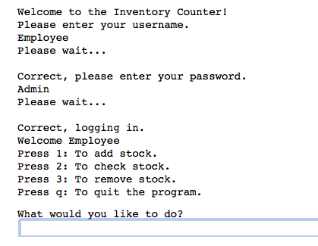
Inventory Counter
Bringing both employees and customers an efficient way to navigate through various products available. Also allowing employees to have administrative capabilities when it comes to editing the inventory amount.
Bailey Underwood &Jorden Kirkland
https://github.com/ksu-is/Inventory_Countern

